Slide 1
How We Ripple: Psychological Flexibility, Individual Wellbeing & Relationship Quality
Karen Twiselton, Dr Sarah Stanton & Dr David Gillanders
University of Edinburgh

Slide 2
Wellbeing and Relationship Quality
Social relationships often viewed as single biggest predictor of subjective wellbeing (Argyle, 2001; Vohs & Finkel, 2006)
Positive relationships linked to lower susceptibility to ailments and to higher quality of life (Uchino, 2006; Chu, Saucier & Hafner, 2010)
Social integration linked to longevity (House, Landis & Umberson, 1988; Lunstad-Holt, Smith & Layton, 2010) and people with a happy spouse live longer (Stavrova, 2019)
Interdependent couple relationships exert their influence at cognitive, affective and behavioural levels (Kelly & Thibaut, 1978)
What role does psychological flexibility play in this context?

Slide 3
Defining our Constructs
Psychological Flexibility
Subjective Wellbeing
Psychological Wellbeing
Relationship Quality
Openness to experience
Behavioural awareness
Valued action
Positive affect
Negative affect
Satisfaction with life
Autonomy
Environmental mastery
Personal growth
Positive relations with others
Purpose in life
Self-acceptance
Closeness
Commitment
Love
Passion
Satisfaction
Trust
CompACT (Francis et al., 2016)
PANAS (Watson et al., 1988)
SWLS (Diener et al., 1985)
PWBS (Ryff, 1989)
PRQC (Fletcher et al., 2000)

Slide 4
Individual level study
Aim: To explore how measures were related
Participants
1176 people in a romantic relationship
Gender: 678 female, 495 male, 2 genderqueer, 1 unreported
Age: 18-76 (M_{years} = 36)
Relationship length: 1 month – 54 years
(M_{years} = 9)
82% Cohabiting
78% Caucasian

Slide 5
Correlations between study variables
 | PF | PA | NA | SWL | PW | RQ
Psychological Flexibility (PF) | - | .33** | -.54** | .40** | .80** | .36**
Positive Affect (PA) |  | - | -.13** | .51** | .48** | .36**
Negative Affect (NA) |  |  | - | -.31** | -.55** | -.26**
Satisfaction with Life (SWL) |  |  |  | - | .61** | .46**
Psychological Wellbeing (PW) |  |  |  |  | - | .47**
Relationship Quality (RQ) |  |  |  |  |  | -
** p<.001

Slide 6
Factor Analysis
Factor 1 | Factor 2 | Factor 3 | Factor 4 | Factor 5 | Factor 6
Life Satisfaction | Relationship Quality | Positive Affect | Valued Action | Behavioural Awareness/ Openness to Experience | Negative Affect
Psychological Wellbeing |  |  | Psychological Wellbeing | Psychological Wellbeing
IWM: .68
IWM: .75
IWM: .72
IWM: .62
IWM: .59
IWM: .74
IWM: .40
IWM: .41
IWM: .36
IWM = Item weighting mean

Slide 7
Structural Relationships
Model | Predictor | Mediator(s) | Outcome(s) | χ2(df), p | CFI | RMSEA
1 | PF | PA, NA | RQ | 3.71(1), p=.054 | >.99 | .05
2 | RQ | PA, NA | PF | 2.23(1), p=.135 | >.99 | .03
3 | PF | RQ | PA, NA | 395.06(3), p<.001 | .50 | .33
4 | RQ | PF | PA, NA | 100.50(3), p<.001 | .88 | .17
5 | PF | LS | RQ | 58.80(1), p<.001 | .30 | .22
6 | PF | RQ | LS | 97.26(1), p<.001 | .82 | .29
7 | RQ | PF | LS | 165.68(1), p<.001 | .69 | .37
8 | RQ | LS | PF | 58.80(1), p<.001 | .89 | .22
9 | PF | PA, NA, LS | RQ | 316.83(4), p<.001 | .77 | .26
10 | RQ | PA, NA, LS | PF | 322.68(4), p<.001 | .78 | .26
11 | PF | RQ | PA, NA, LS | 703.83(6), p<.001 | .49 | .32
12 | RQ | PF | PA, NA, LS | 477.68(6), p<.001 | .65 | .26

Slide 8
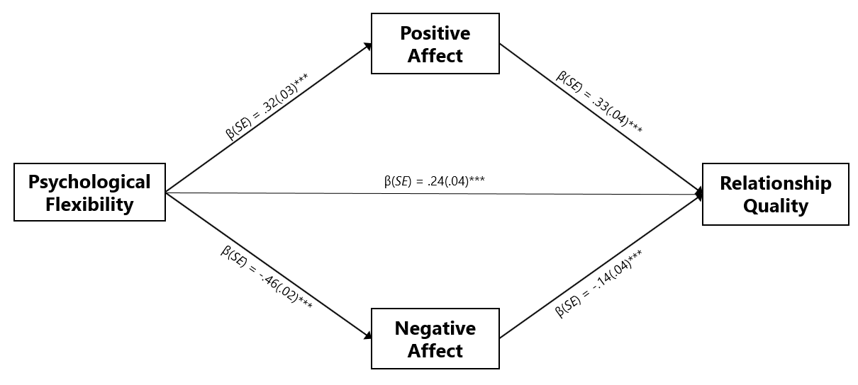
Model 1

Slide 9
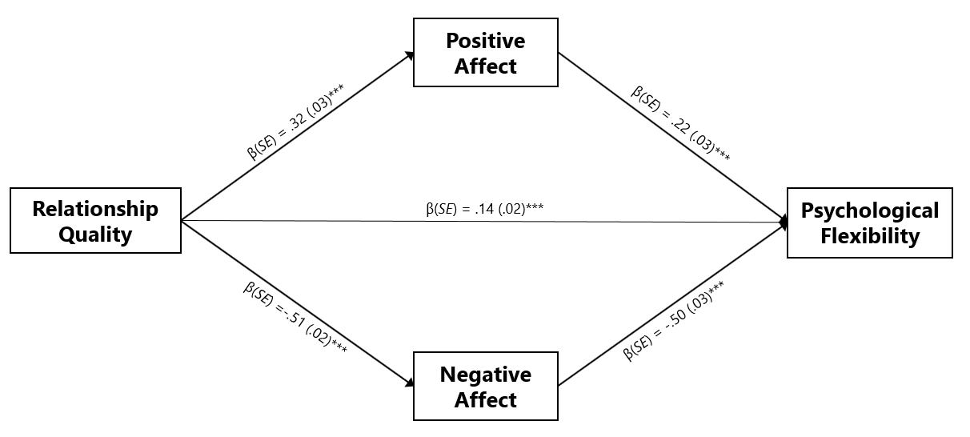
Model 2

Slide 10
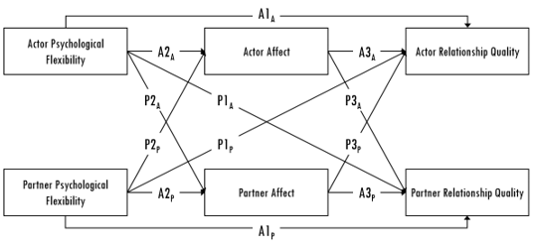
Dyadic Study
Aim: To replicate our findings at the couple level, exploring cross- partner effects using APIMeM in MPLUS
Participants
Sample size: 212 couples
Aged 18-83 (M_{years} = 45)
Relationship length 1 – 65 years (M_{years} = 15)
93% Cohabiting
75% Caucasian
244 female, 170 male, 6 genderqueer, 4 unreported
Notes:
53.8% heterosexual
29.7% lesbian
12.3% gay

Slide 11
Correlations between study variables
 | PF-A | PF-P | PA-A | PA-P | NA-A | NA-P | RQ-A | RQ-P
Psychological Flexibility-Actor (PF-A) | - | .63** | .22** | .14** | -.54** | -.44** | .12** | .11*
Psychological Flexibility-Partner (PF-P) |  | - | .14** | .22** | -.44** | -.54** | .11* | .12**
Positive Affect-Actor (PA-A) |  |  | - | .71** | -.14** | -.07 | .41** | .38**
Positive Affect-Partner (PA-P) |  |  |  | - | -.07 | -.14** | .38** | .41**
Negative Affect-Actor (NA-A) |  |  |  |  | - | .82** | -.16** | -.12*
Negative Affect-Partner (NA-P) |  |  |  |  |  | - | -.12* | -.16**
Relationship Quality-Actor (RQ-A) |  |  |  |  |  |  | - | .84**
Relationship Quality-Partner (RQ-P) |  |  |  |  |  |  |  | -
*p < .05, **p < .01

Slide 12
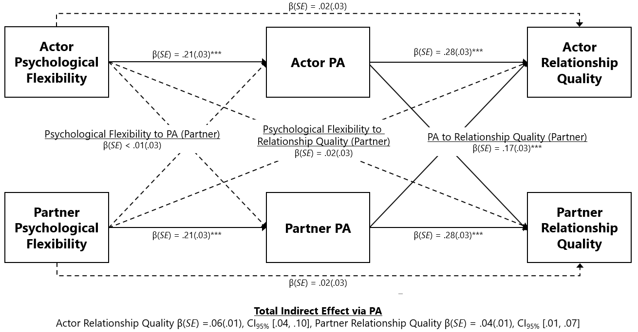
Positive Affect as Mediator

Slide 13
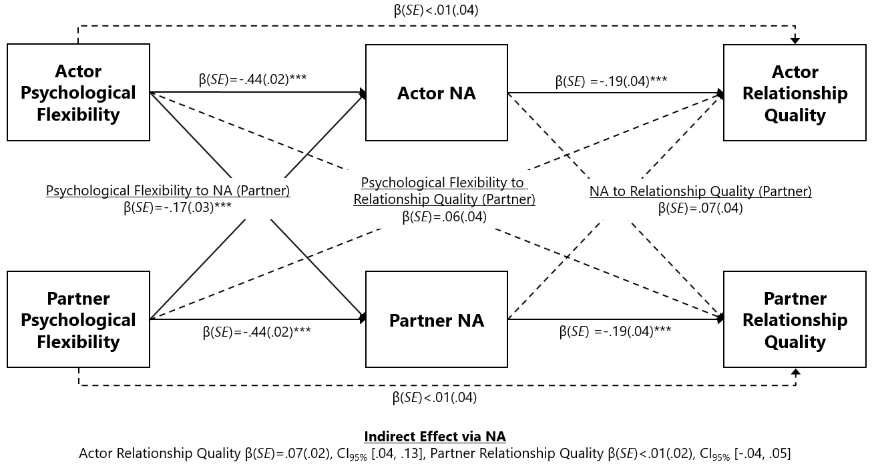
Negative Affect as Mediator

Slide 14
Discussion
Wellbeing has distinct facets: psychological flexibility offers a discrete contribution to the understanding of wellbeing in our data
Affect has an important role in mediating the relationship between psychological flexibility and relationship quality
Cross-partner associations differ for positive and negative affect

Slide 15
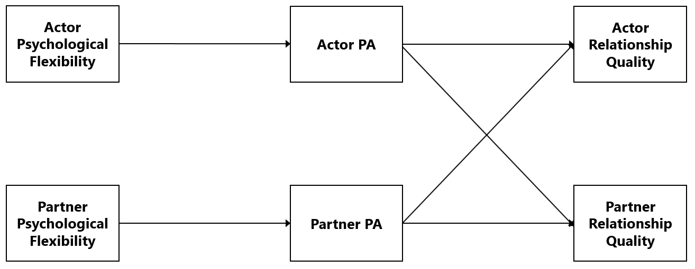
Being psychologically flexible may mean that people are more present in their relationships, and more aware of and committed to their relationship goals. This may make them happier.
The higher sociability linked to positive affect may support enhanced communication about own and partner expectations, goals, needs and desires affording an opportunity for people to behave more effectively in their relationship.

Slide 16
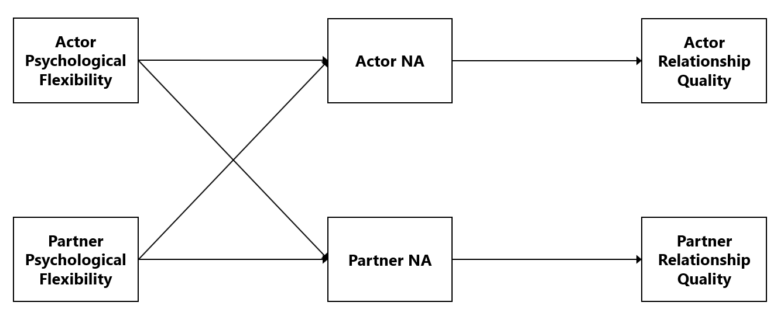
At low psychological flexibility, being less present in their relationship and more closed to experience may contribute to a diminished sense of wellbeing associated with negative affect. Partners may find this difficult to be around and experience higher negative affect themselves.
High negative affect may lead to people to effectively shut down and become less able to appreciate their relationship.

Slide 17
Limitations and Future Directions
Data is cross-sectional: we’re unable to draw causal conclusions about how psychological flexibility, affect and relationship quality are linked. Over time studies would help to establish causality.
Sample characteristics reinforce need for replication.
These studies focus on perceptions of relationship quality and we need to explore the behaviours that reflect relationship quality and how these vary based on actor and partner psychological flexibility.

Slide 18
Thank you!
Further details available at:
Twiselton, K., Stanton, S.C.E., Gillanders, D. & Bottomley, E. (in press) Exploring the links between psychological flexibility, individual wellbeing and relationship quality. Personal Relationships
https://osf.io/5tsh2/
Karen.Twiselton@ed.ac.uk

